Slide 1
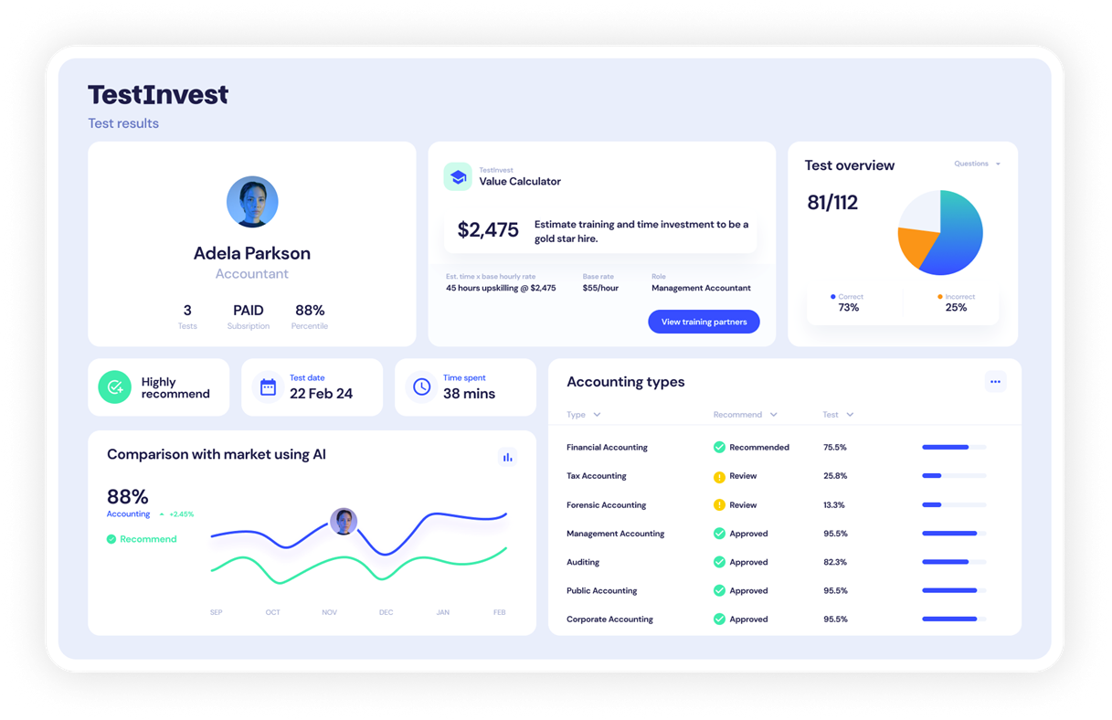


AUSTRALIA’S FIRST ONLINE PLATFORM VERIFIYING REAL SOFTWARE PROFICIENCY
Notes:
Hi everyone, my name’s Tom, and I’m a co-founder of TestInvest.
Today, I want to talk about one of the most expensive and frustrating problems in business — making the wrong hire.

Slide 2



THE PROBLEM
Businesses can’t accurately verify software proficiency before hiring, leading to costly mistakes and inefficiency
2.5X
RESUMES
ANNUAL SALARY
ARE OBSOLETE
The cost of a bad hire to a business.
(SHRM, 2023)
Employers can’t verify software proficiency before hiring.
1 TRILLION
WEEKS OF
LOST PRODUCTIVITY
IN LOSSES
The impact of poor hiring decisions to the U.S. economy annually (Gallup, 2023).
New hires often need weeks of training and onboarding to achieve proficiency.
Hiring is moving towards skills validation and measurable competencies
Notes:
Hiring is expensive when it goes wrong. A bad hire can cost a business up to two and a half times that person’s annual salary once you add in lost productivity, rehiring, and training costs.
For small and medium businesses, that’s a huge hit.
My co-founder Kris saw this problem first-hand when she was running her accounting firm. She asked a recruiter how confident they were that a candidate actually knew how to use Xero, and the answer was: “not very.” That moment was the spark for TestInvest.
And that brings me to the solution.

Slide 3






THE TEAM
Experienced and driven leadership
Kristen Kubank
DIRECTOR & CO-FOUNDER
Kristen Kubank
Director
Tom Kubank
Co-Founder
  Partner - Carbon Group Adelaide
  CFO of ASX-listed Sparc Technologies (ASX: SPN).
  Recently sold her accounting business to focus on innovation in recruitment technology.
  1st South Australia / Northern Territory Accredited Xero Trainer.
  Proven track record of scaling startups.
Tom Kubank
Zac Bailey
BUSINESS DEVELOPMENT & CO-FOUNDER
  Director of Digital Elite Website Design.
  Former Professional athlete who played with the Adelaide 36ers.
  Marketing Manager for Sparc Technologies (ASX: SPN).
  High achiever who excels in implementing vision and strategy.
Software Development
James Anthony Group / Zac Bailey
Investment Advisor
Sasha Baranikov / Steam Ventures
Accounting and I.T.
Carbon Accounting / Crestech
HR and L&D Industry Expert
Jenny Briggs
Notes:
Kris, my co-founder, is taking on CEO responsibilities, including financial modelling and strategy.
My focus is on product development, business development, and sales and marketing. Between us we bring a mix of operational, technical, and commercial skills that balance each other well.
And of course, we’re building out advisory and technical support around us as we grow.

Slide 4






OUR SOLUTION
TestInvest is an online platform that verifies real software proficiency through interactive software skills tests.
We help businesses hire smarter; reduce hiring risk and training costs
We help candidates prove their proficiency and identify strengths, weaknesses and areas for upskilling through personalised insights from our tests
Test
Identify Skill Gaps
Train and Improve
Hire with Confidence
Notes:
TestInvest is a software skills testing platform designed to take the guesswork out of hiring. We help businesses verify a candidate’s proficiency in the software they’ll actually use on the job.
Our first focus is accounting, where Xero and MYOB are critical tools. From there we’ll expand into areas like Power BI, Adobe, and other industry-specific software.
The aim is simple: give employers confidence in who they’re hiring, and give candidates a way to showcase their real abilities.
Now, what sets us apart is the advantage we bring.

Slide 5



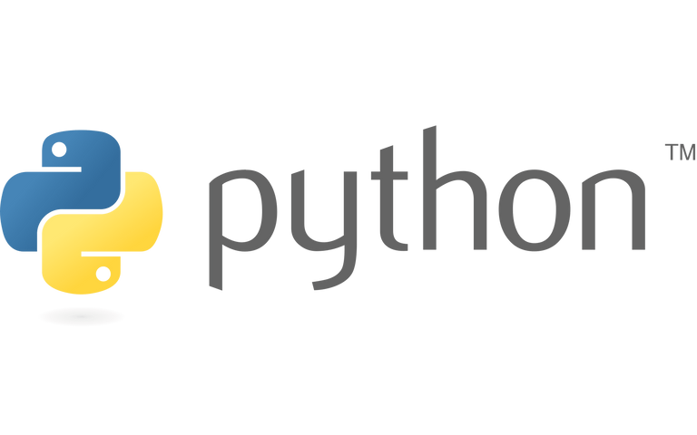









OUR SOFTWARE TEST ECOSYSTEM
Our tests cover the tools professionals use everyday
Globally scalable across many industries and softwares

Slide 6
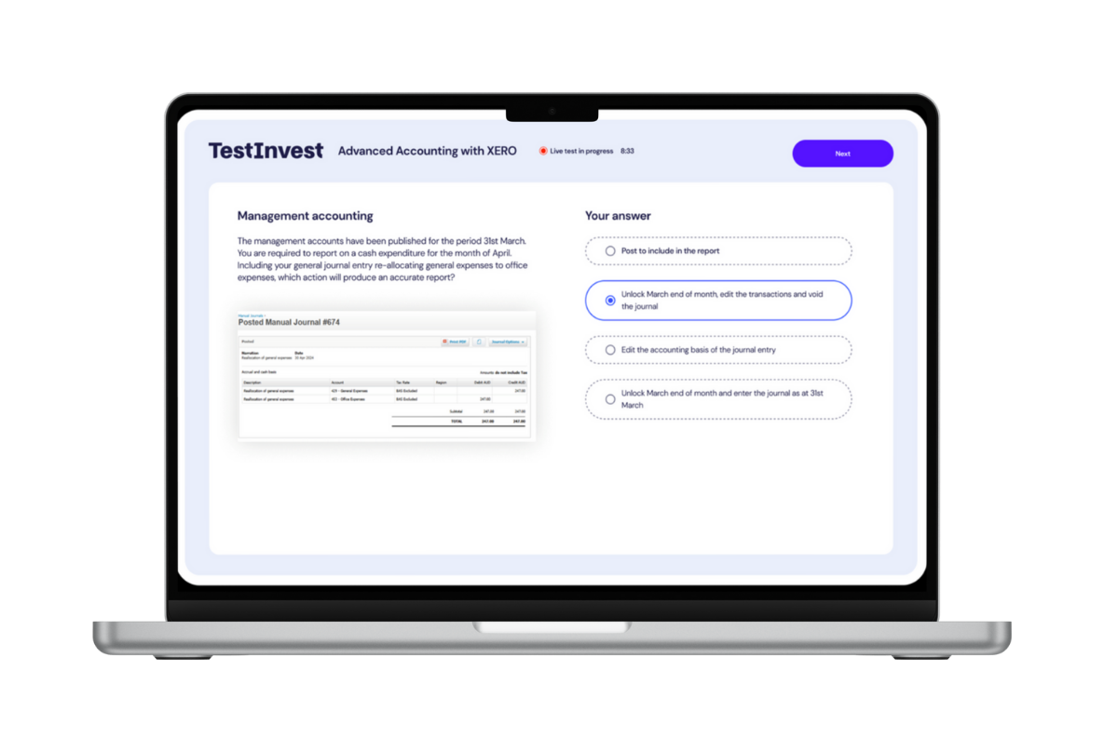
THE TESTINVEST ADVANTAGE
Reducing hiring risk and improving team performance through real software testing
30%
Reduction in time-to-hire
60%
Reduce training costs by targeting task-specific needs
36%
Improvement in employee retention rates
Notes:
This is where TestInvest really stands out. Our platform creates measurable impact for businesses. Early projections show:
36% reduction in time-to-hire
30% improvement in employee retention
60% savings in training costs by identifying exactly where development is needed
On top of that, our tests are tailored to the software employers actually care about, with AI-driven analytics that provide actionable insights for both businesses and candidates.
So, instead of relying on CVs or inflated claims, companies get clear evidence. Candidates, on the other hand, gain a tool they can use to prove their worth.
With that in mind, let’s take a look at the market we’re entering.

Slide 7




OUR CORE FEATURES
Built to deliver accurate insights, improve hiring confidence, and unlock workforce potential
Expert-Written Tests
AI Personal Proficiency Plan
Employee Value & Upskilling Cost Calculator
Talent Pool of Qualified Candidates
Comprehensive assessments created and reviewed by certified subject matter experts to ensure accuracy, industry relevance, and real-world applicability.
Automatically generates a personalised development plan based on test results- identifying strengths, weaknesses, and recommended upskilling paths.
Instantly quantifies the financial impact of a hire - estimating onboarding cost and potential ROI from targeted upskilling.
Centralised hub of verified candidates, searchable by proficiency level, software, and role type - connecting businesses with job-ready talent.

Slide 8


THE AU MARKET OPPORTUNITY
5 year projection
Customers Metrics
B2B
B2C
  9 industries identified
  Small, Medium & Enterprise target focus needs validating
  3 Jobseeker groups - Job seekers, job changers & students
  One-to-many go to market oppportunity
  Currently testing product market fit
  Refining ideal customer profiles
TAM
A$800M
TAM
A$800M
Businesses in targeted industries -
337,000 businesses
8 million job seekers / changers @
$99 per test
SAM
A$57M
SAM
A$40M
Customers Segments
27,000 businesses
5% market penetration
  Businesses and SMEs
  Software companies
  Vocational Education
  Recruitment agencies
  Offshore labour-hire and outsourcing companies
  Jobseekers and career changers
  Government employment agencies
SOM
A$28M
SOM
A$2M
13,700 businesses
20,000 job seekers / changers
Notes:
Skills testing is already a large and growing space. The global pre-employment testing market is worth billions, and it’s projected to keep expanding as companies shift toward skills-first hiring.
Accounting alone gives us a strong beachhead, but the broader opportunity is in every industry where software is central to the role.
So how do we reach this market and turn it into business?
Right now we’re engaging directly with our industry contacts in accounting to fill our pilot program. We’ve already had positive conversations, with a couple of firms giving us verbal commitments and interest in signing letters of intent.
We’re also using social media to build visibility with recruiters, accounting firms, and business owners. As we grow, these early adopters will help us refine the product, prove value, and generate case studies we can use to scale.

Slide 9
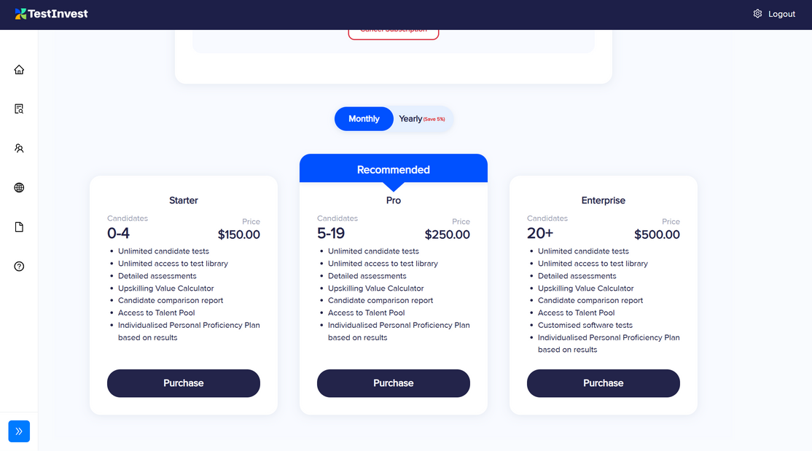
THE REVENUE MODEL
Dual-channel monetisation - built for scale
B2B
B2C
Subscription service
Individual test purchases
Starter
Professional
Enterprise
$150/mo
$250/mo
$500/mo
Single Test
Test & Re-Take Bundle
Three Test Bundle
$99 AUD
$129 AUD
$250 AUD
Future Revenue Streams:
Partnership commissions | White-label licensing | Talent Pool | DaaS | Training Referrals
Notes:
In December we’ll be seeking $350,000 investment. The funding will give us around 12 months of runway. That capital will go into product development, scaling our marketing and sales efforts, and covering operating costs like salaries and support staff.
The key for us is to make sure we don’t run out of momentum, and this investment gives us the space to prove traction and grow quickly.

Slide 10




THE COMPETITIVE LANDSCAPE
Focused on software skills. Powered by AI insights. Two sided model.
Rich
Niche Software Focus vs. Broad Suite
AI Analytics and Behavioural Tracking
Depth of Software Proficiency Testing
Personal Proficiency
Plans
Talent Pool for Qualified Candidates
Low
High
Actionable Insights & Analytics
5,300 Clients in First 2 Years
(U.S. based)
8,000+ Clients
*Selected features. Positioning illustrative.

Slide 11




PRODUCT ROADMAP
Q4 2027 - Market Expansion
  Expansion into SE Asian, US and UK markets
2028
Q2 2026 - Market Launch
  Public launch with targeted marketing campaigns focusing on the accounting and recruitment industries
Q4 2025 - MVP Launch
  Release functional MVP with automated skills testing and AI powered reporting
  Pilot program with select group of accounting and recruitment firms to gather feedback and refine
Q1 2027 - Scale and Expand
  Add tests for additional software tools.
  Grow user base to 100+ B2B users and strengthen market position
Q2 2026 - Product Refinement
2025
  Add key improvements such as enhanced reporting tools, test type variety, ATS integration and admin dashboards - Greater testing functionality means more softwares and industries we can offer our product to
Notes:
So far, we’ve built the concept, secured interest from pilot partners, and developed mockups for the testing process and results dashboard.
Our next milestone is delivering the MVP in early December, validating it with firms in the pilot program, and preparing for a broader launch.
That leads me to the investment that we'll need come December.

Slide 12



STRONG FOUNDATIONS FOR SCALE
Validated traction, investor incentives and de-risked growth pathway
IP Protection Secured
Australian R&D Tax Incentive Registered
(#IR2504757)
Early Stage Innovation Company (ESIC) Approved
$55K Initial Pre-Investment Secured
Proprietary testing framework and reporting design safeguarded under registered IP.
Government recognised R&D status confirms TestInvest as an innovation driven business, reducing development costs and investor risk.
Investors receive 20% tax offset (up to $200K p.a.) and a 10 year CGT exemption on qualifying shares.
Inital external capital validated our concept and team. Backed by early supporters pre-MVP.

Slide 13
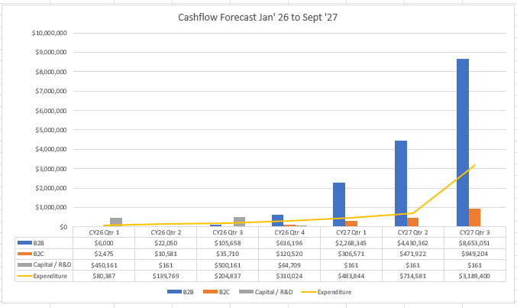
THE FINANCIALS
2 year revenue and profit projections
  9 industry verticals underpin the model
  85% gross margins and <24-month break-even timeline
  High margin SaaS model with recurring revenue and scalable growth across industries
$30M
PROJECTED REVENUE IN 5 YEARS
(~3.5% of $800M TAM).

Slide 14
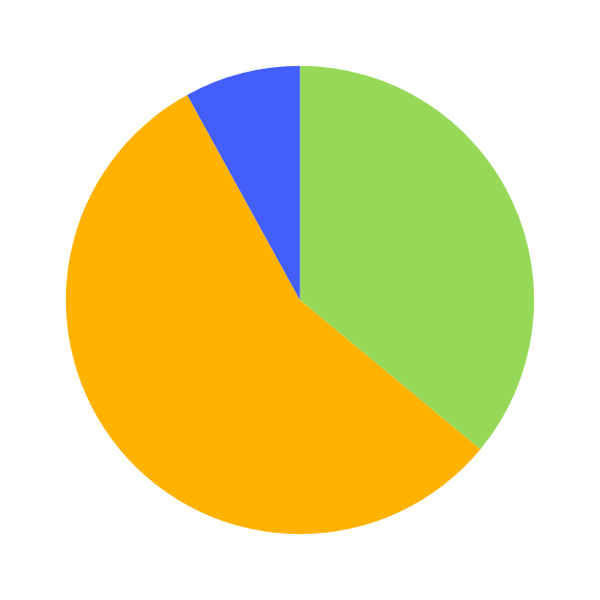
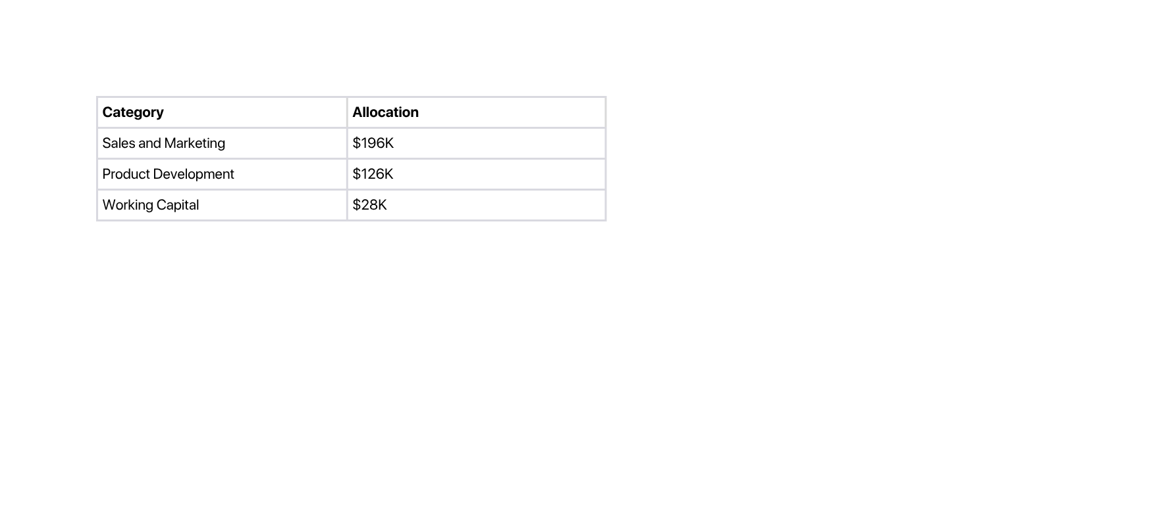
INVESTMENT
Allocation of funds
Investment ask and use of funds
8%
Working capital
$350K
36%
THE ASK
With MVP complete and early customers committed, this round fuels our launch and rapid market adoption
Product Development
56%
Sales and Marketing
$500K-1M
FUTURE RAISE SEPT. 26'
$30M+
5 YEAR EXIT PATHWAY
•Trade sale or Strategic Acquisition
• Private Equity or VC Acquisition
SAFE NOTE
INVESTMENT INSTRUMENT
Notes:
In December we’ll be seeking $350,000 investment. The funding will give us around 12 months of runway. That capital will go into product development, scaling our marketing and sales efforts, and covering operating costs like salaries and support staff.
The key for us is to make sure we don’t run out of momentum, and this investment gives us the space to prove traction and grow quickly.

Slide 15
KRISTEN KUBANK
TOM KUBANK
Co-Founder
kristen@testinvest.com.au
+61 434 044 131
Co-Founder
tom@testinvest.com.au
+61 447 537 451
Notes:
Thank you for your time. We’re excited about the impact TestInvest can have in reducing the cost of bad hires, and we’d love to have you join us on the journey.

